Slide 1
Date: 16 December 2025

Slide 2
Weekly Presentation : Rotor Bearing System
Week number: 12
Date: 16 /12/2025
Supervisor: Prof. Peter Quell
Group members: Divyesh Mistry, Venkata Sreekanth .K , Sreehari Padachery, Jill Sadariya
Presenter : Divyesh Mistry

Slide 3
Agenda
Bearing
Bearing Housing.
Shaft.
Rotor Lock Disc.
Rotor Lock Pin.
Lock nut
Rotor Bearing Assembly.
Lock pin calculation using new Load cases
Bibliography.
Divyesh Mistry

Slide 4
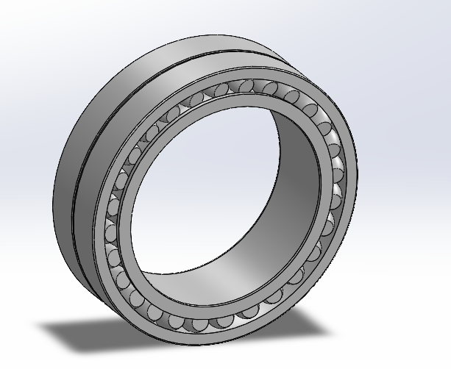
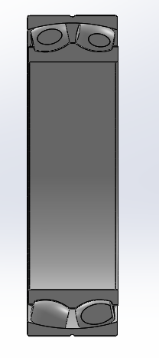
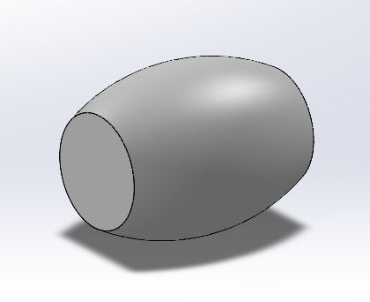
Bearing
parameter | value | unit
Bore diameter | 1600 | mm
Outer diameter | 2240 | mm
Total width | 630 | mm
Rollers per row | 28 | numbers
Roller diameter | 131.60 | mm
Roller length | 249 | mm
Safety factor | 09
(Own Design)
Divyesh Mistry

Slide 5
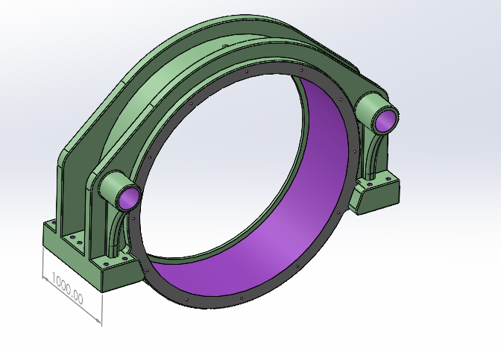
Bearing Housing
parameter | value | unit
OD | 2500 | mm
ID/Bore dia | 2240 | mm
Width | 720 | mm
Total lenght | 3200 | mm
Rib Radius | 1400 | mm
Length of the Legs | 1000 | mm
(Own Design)
Divyesh Mistry

Slide 6
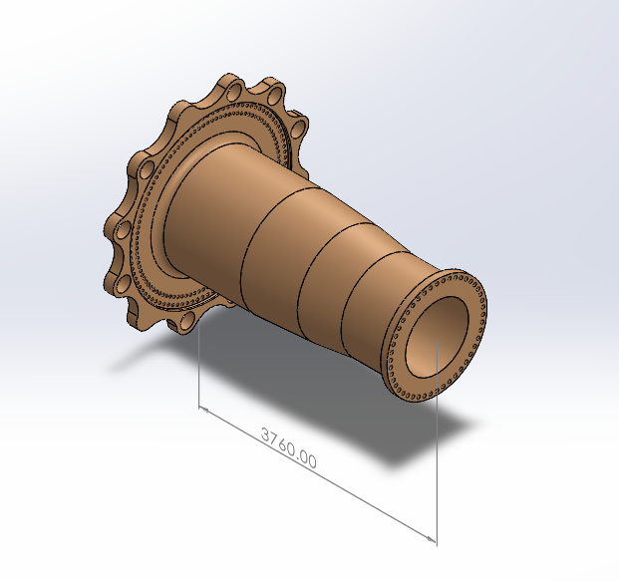
Rotor Shaft
Hub Side Flange
Description | Symbol | Value | Unit
Outer screw circle diameter | dt2 | 2450 | mm
Inner screw circle diameter | dt1 | 2250 | mm
No. of screws per bolt circle diameter | N_{total} = N_{ICB} + N_{OCB} | 94+102=196
Integrated rotorlock Flange outer dia | D_{flange} | 3190 | mm
Integrated Flange Thickness | _{t} | 200 | mm
Gear box Side Flange
Description | Symbol | Value | Unit
screw circle diameter | dt1 | 1464 | mm
No. of screws per bolt circle diameter | N_{total} | 46
Flange outer dia | D_{flange} | 1584 | mm
(Own Design)
Divyesh Mistry

Slide 7
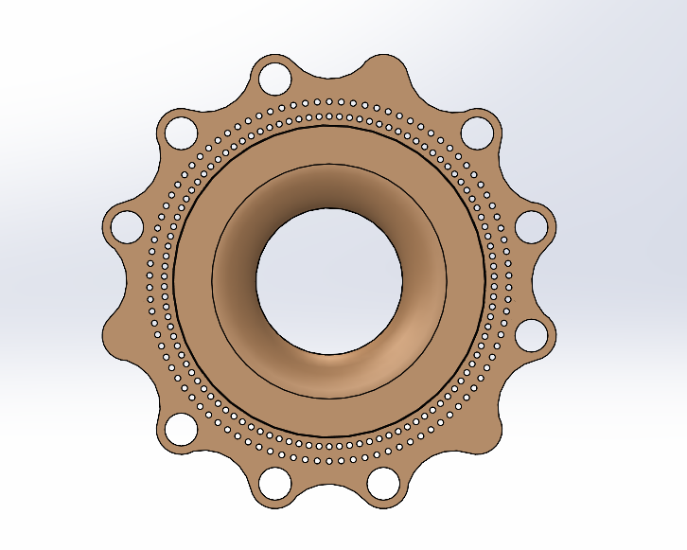
Rotor Lock Disc
Blade & Reference Angle | 1-pin Angle | 2-pin Angle
1st Blade (0∘) | 15 | 165
2nd Blade (0∘) | 255 | 45
3rd Blade (0∘) | 135 | 285
1st Blade (90∘) | 285 | 75
2nd Blade (90∘) | 165 | 315
3rd Blade (90∘) | 45 | 195
*Value we assigned based on our assumption
(Own Design)
Divyesh Mistry
Source: LLM(Large Language Models).

Slide 8
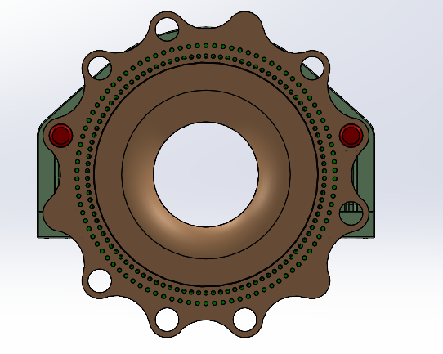
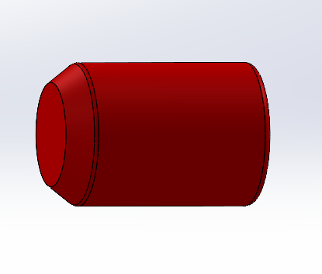
Rotor Lock Pin
L2
D2
D1
L1
parameter | value | unit
L1 | 280 | mm
L2 | 40 | mm
D2 | 160 | mm
D1 | 220 | mm
(Own Design)

Slide 9
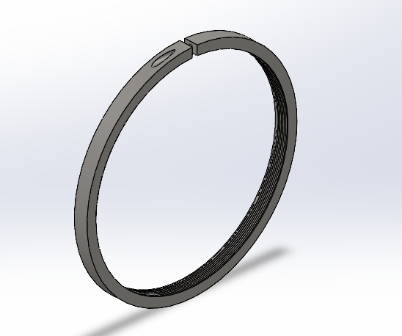
Lock Nut
Thread | Outer diameter | Width | Gap width | Thread for mounting lever
G | d3​ | B | b | G1​
Tr 1600x 8 | 1750 | 110 | 40 | M24
(Own Design)

Slide 10
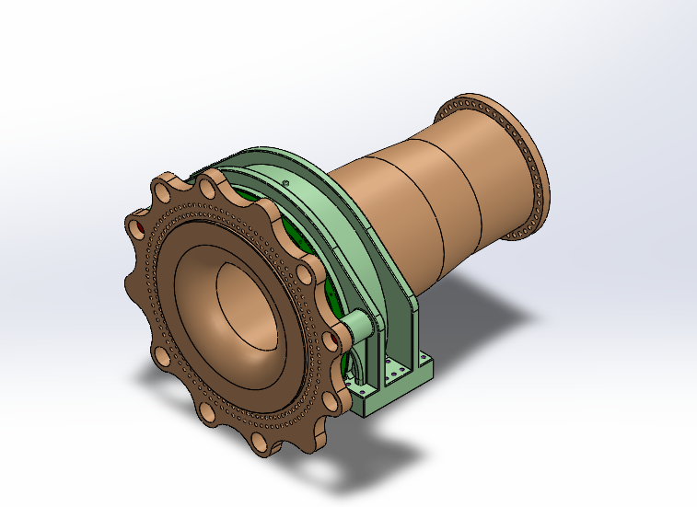
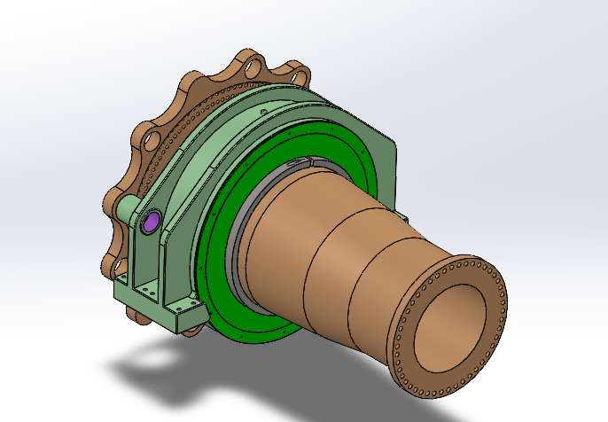
Rotor Bearing Assembly
(Own Design)
Divyesh Mistry

Slide 11



Lock pin calculation using new Load data
$\text{F} \text{=}\frac{\text{M}T}{\text{2∗}\text{r}}$
where, Lock pin hole circle radius r = 1425mm
Torsional moment Mt= 24435 KN.m ( 250% * Rated Torque (9774KN.m)
$\text{F} \text{= 8573.68 }\text{KN}$
Thickness of Integrated rotor lock disc = Flange thickness+thickness of disc= 200 mm
Bending Moment acting on the Lock pin ,M_{bpin=}F*L
M_{bpin=} 943105.2 KNmm
Allowable bending stress of the steel material = 0.66f_{y} (As per Steel Design Indian Standard (IS) 800, American Institute of Steel Construction (AISC) ASD 9th Edition
pressure acting on the hole of the disk , $\text{P} \text{=}\frac{\text{F}}{\text{A}}$
Source: Optimus Shakti

Slide 12
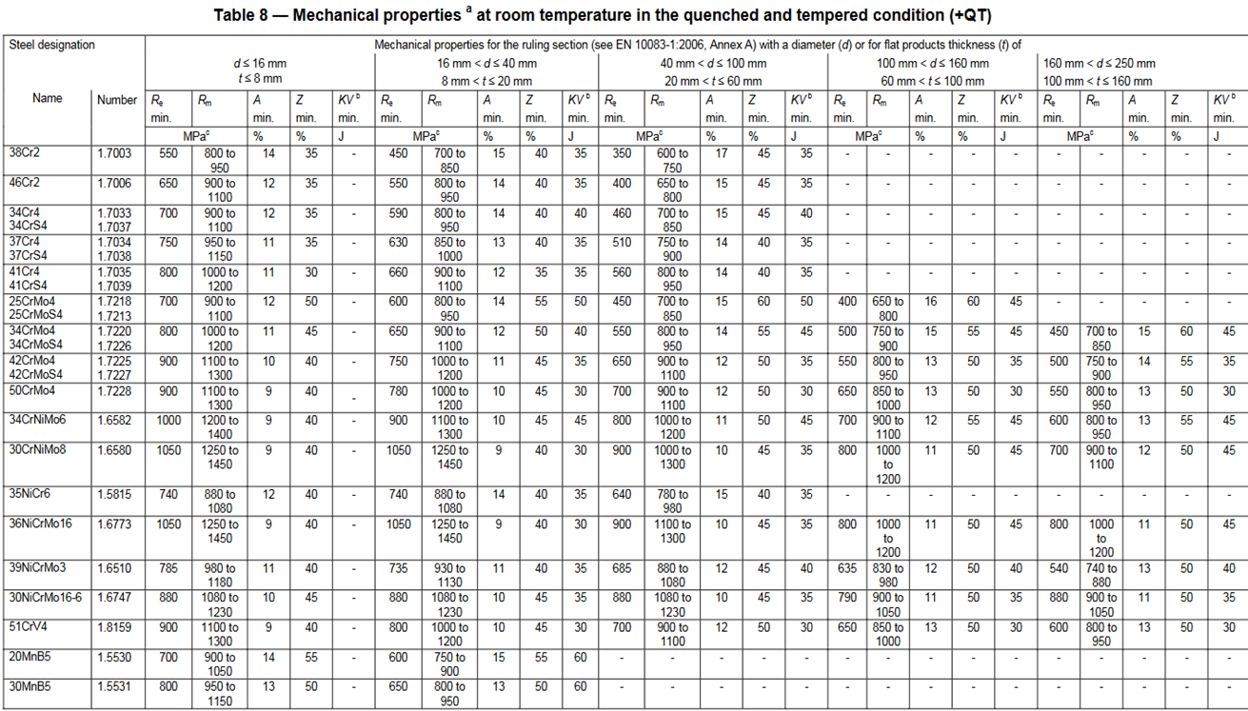


Material | Yield Strength | Case 1 (σ = f_{y}) | Case 2 (σ = 0.66 f_{y})
30 NiC rMo16-6 | 880 MPa | 221.84 mm | 254.79 mm
42CrMo4 | 500 MPa | 267.83 mm | 307.61 mm
Difference | -380 MPa | +46 mm | +53 mm
$\text{σ} \text{=}\frac{\text{M} \text{b}\text{,}\text{pin}}{\text{W}}$
$\text{W}\text{=}\frac{\text{π}\text{ × }\text{d}\text{3}}{\text{32}}$
pressure acting on the hole of the disk , $\text{P} \text{=}\frac{\text{F}}{\text{A}}$
(From DIN EN 10083-3,Table 8)
Area (A) = Hole Diameter* Thickness of flange
Source: Optimus Shakti

Slide 13
Material | Case (Yield Strength Basis) | Pin Diameter (mm) | Hole Diameter (mm) | Area (mm²) | Pressure (N/mm²)
30 NiCrMo16-6 | Case 1 (σ=fy​) | 221.84 | 224.84 | 44,968 | 190.66
30 NiCrMo16-6 | Case 2 (σ=0.66fy​) | 254.79 | 257.79 | 51,558 | 166.29
42CrMo4 | Case 1 (σ=fy​) | 267.83 | 270.83 | 54,166 | 158.29
42CrMo4 | Case 2 (σ=0.66fy​) | 307.61 | 310.61 | 62,122 | 138.01

Slide 14
Bibliography – Rotor Bearing System
Optimus Shakti, Optimus 60E
ITH. (n.d.). ITH Hydraulic Torque Wrenches Catalog. Retrieved November 08, 2025, from www.ITH.de/schraubwerkzeuge/hydraulische-drehmomentschrauber
DIN EN 10083-3: Steels for quenching and tempering – Part 3: Technical delivery conditions for alloy steels. Retrieved November 22, 2025, from https://studylib.net/doc/18166049/din-en-10083-steel-for-quenching-and-tempering-part-3-
American Institute of Steel Construction. (1989). Manual of Steel Construction: Allowable Stress Design (9th ed.). Chicago, IL: Author. Retrieved November 22, 2025, from Internet Archive (Manual of Steel Construction: Allowable Stress Design, 9th Edition)
LLM(Large Language Models).
Germanischer Lloyd Industrial Services GmbH, Renewables Certification. (2010). Guideline for the certification of wind turbines.
Boltport Fasteners. (n.d.). DIN 125 Flat Washers Weights Chart. Retrieved December 8, 2025, from https://boltport.com/weights/din-125/
M. Wilhelmsen A/S. (n.d.). STEEL BOLT M48X240 10.9 DIN 931. Abgerufen am 8. Dezember 2025, von https://ehandel.mw.dk/en/steel-bolts-din-931/steel-bolt-m48-109
Divyesh Mistry

